Slide 1
AGENTIC AI SYSTEMS | WEEK 3 PROJECT
Trade Deep Agent
A Multi-Agent, Human-in-the-Loop Framework for
Trade Idea Review, Risk Sizing & Compliance Sign-off
Built on LangGraph Deep Agents · Orchestrator + 4 Specialist Subagents · LangSmith Observability
Prepared for: Financial Portfolio Trade Review & Compliance Process

Slide 2
Agenda
01
The Problem Why manual trade review and compliance checks don't scale
02
Solution Overview Deep Agents framework: orchestrator + isolated subagents
03
System Architecture How the components fit together
04
Agent Assembly Configuring the agent — model, backend, store, skills
05
Data Flow How information moves through the system
06
Run-Time Workflow Step-by-step execution sequence
07
Human-in-the-Loop & Governance Where people stay in control
08
Monitoring & Observability LangSmith tracing on the live project
09
Benefits & Value Add Impact on the trade review & compliance process
Trade Deep Agent | Agentic AI Systems Project
2

Slide 3
The Problem: Trade Review Doesn't Scale Manually
Fragmented research
Inconsistent rigor
Macro/technical context, risk sizing, and compliance rules live in different heads, files, and tools — reassembled by hand for every idea.
Without a structured checklist, conviction calls and risk caps vary by reviewer, day, and workload.
Slow compliance loop
No durable audit trail
Position-limit and exposure checks are often a late, manual gate rather than built into the review itself.
Verbal or ad hoc reviews leave little record of why a trade was approved, modified, or rejected.
Trade Deep Agent | Agentic AI Systems Project
3

Slide 4
Solution: A Deep Agent for Trade Review
Trade Deep Agent is built on the LangGraph Deep Agents framework: a single orchestrator plans the work and delegates to specialist subagents, each running in its own isolated context, while a human reviewer makes the final call before any trade is recorded.
1
2
3
4
Plan
Delegate
Remember
Govern
write_todos breaks each trade idea into a tracked checklist the orchestrator executes step by step.
task() calls hand off research, sizing, compliance, and critique to four focused subagents.
A shared filesystem (memories, research, risk profile) persists context across the session and beyond.
interrupt_on pauses execution at the trade-approval step until a human explicitly approves, edits, or rejects.
Trade Deep Agent | Agentic AI Systems Project
4

Slide 5
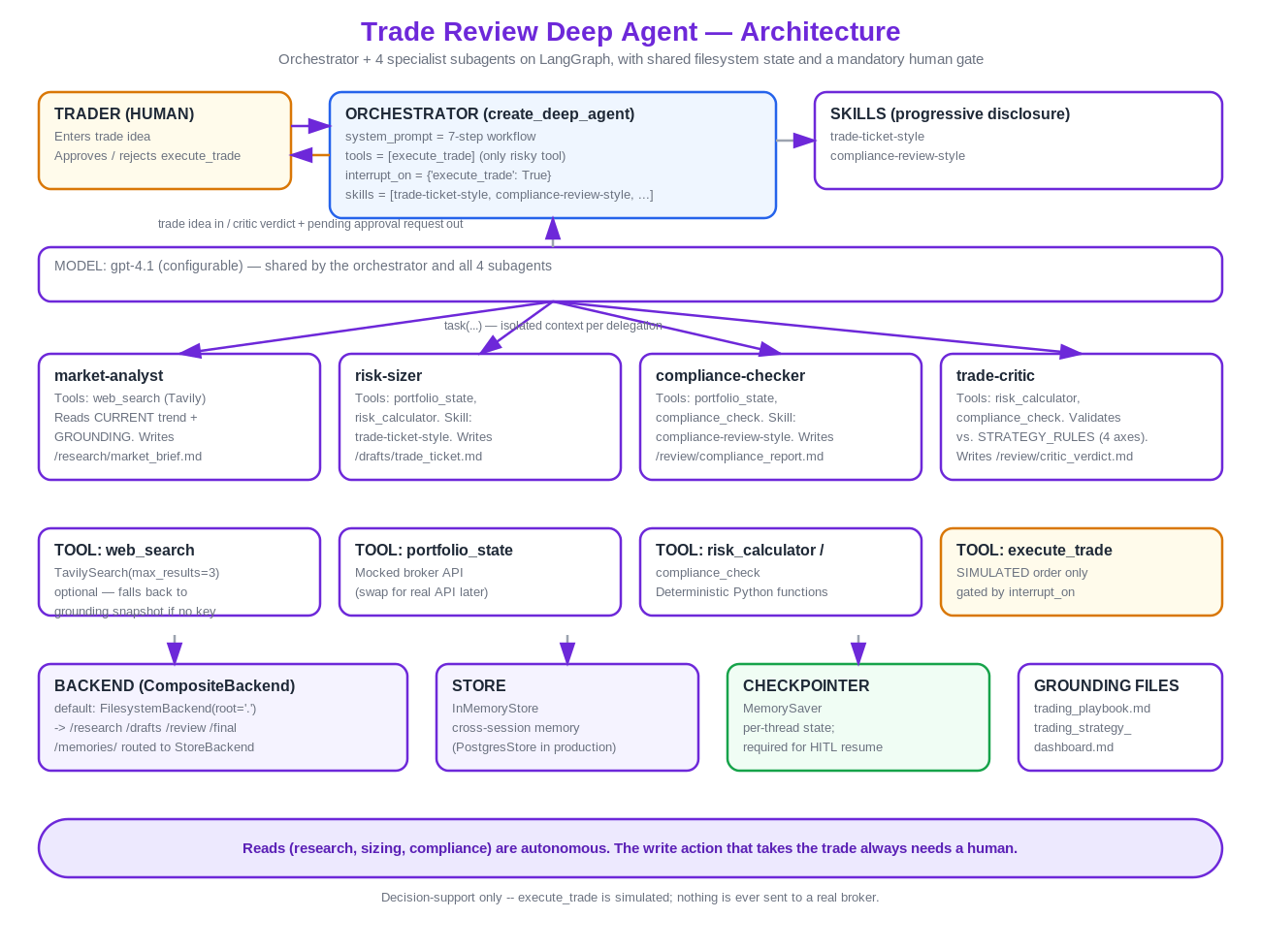
System Architecture
Trade Deep Agent | Agentic AI Systems Project
5

Slide 6
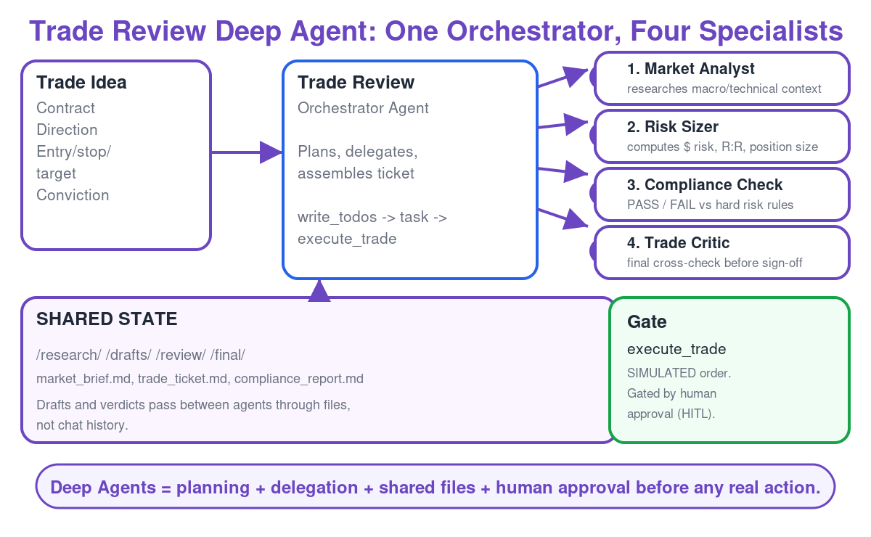
Trade Review Deep Agent: One Orchestrator, Four Specialists
Trade Deep Agent | Agentic AI Systems Project
6

Slide 7
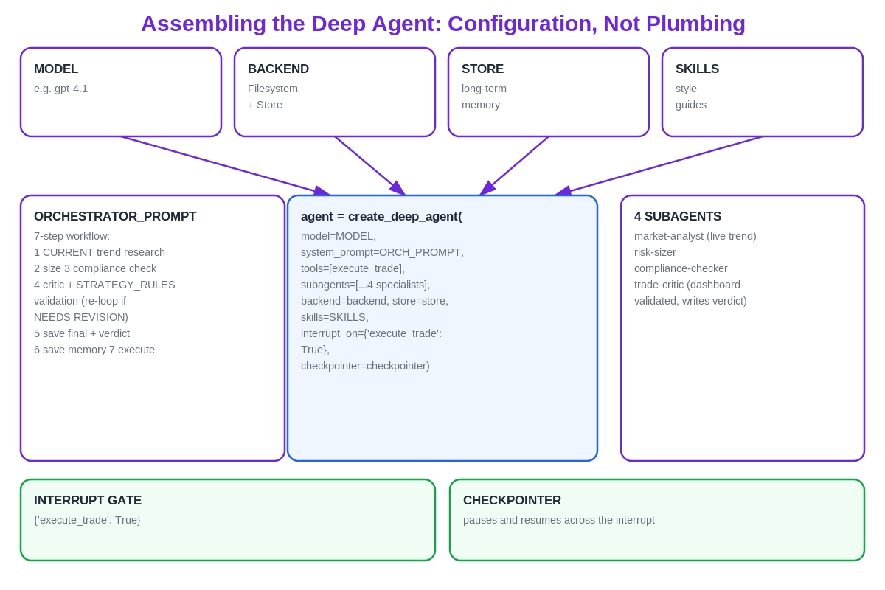
Agent Assembly: Configuration, Not Plumbing
Trade Deep Agent | Agentic AI Systems Project
7

Slide 8
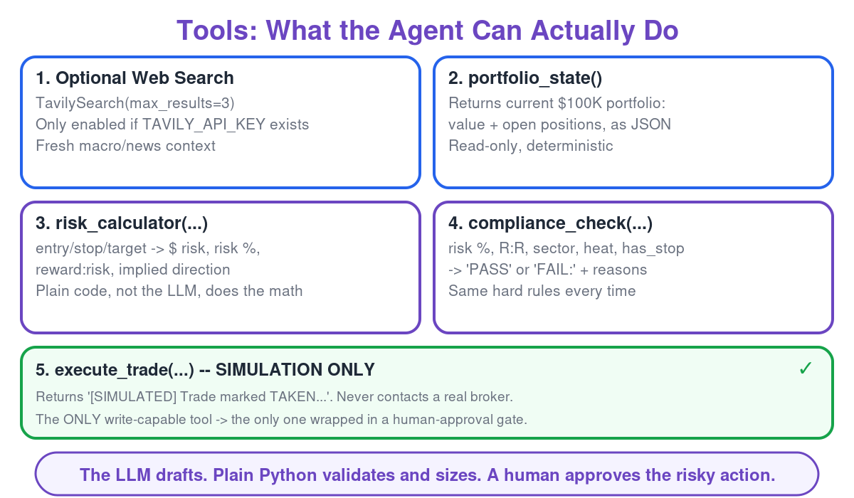
Tools: What the Agent Can Actually Do
Trade Deep Agent | Agentic AI Systems Project
8

Slide 9
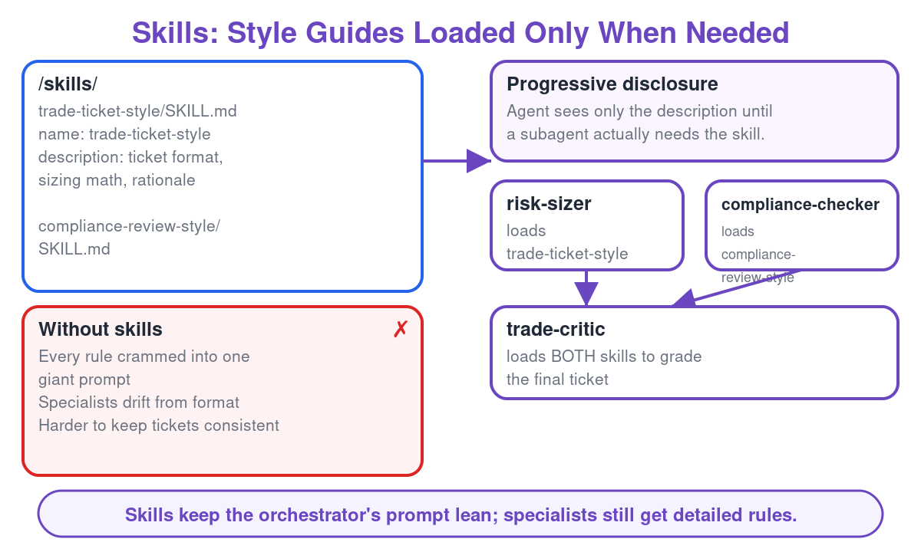
Skills: Style Guides Loaded Only When Needed
Trade Deep Agent | Agentic AI Systems Project
9

Slide 10
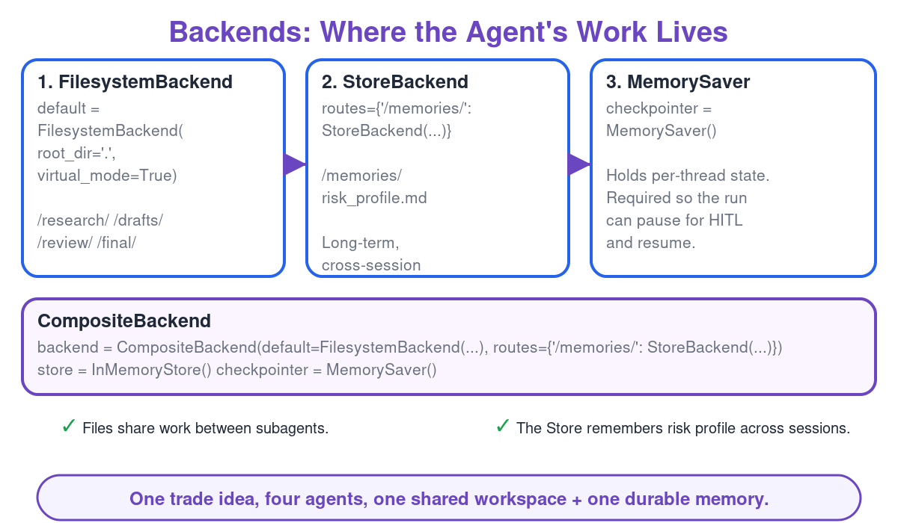
Backends: Where the Agent's Work Lives
Trade Deep Agent | Agentic AI Systems Project
10

Slide 11
Four Specialist Subagents, One Division of Labor
market-analyst
risk-sizer
compliance-checker
critic
Reads the CURRENT technical/macro trend for the contract (live web search, falling back to a labeled grounding snapshot) and issues a HIGH/MEDIUM conviction call.
Checks proposed entry/stop/target against hard position-size and exposure caps from the trading playbook.
Validates the trade against compliance rules (restricted lists, concentration limits) before it can proceed.
Cross-checks the trade against the strategy dashboard's live per-contract grade and entry/exit/sizing rules — a final sanity pass before human approval.
TOOLS Web search + grounding files
TOOLS Calculator tool only
TOOLS Compliance tool only
TOOLS Review tools + strategy dashboard
Trade Deep Agent | Agentic AI Systems Project
11

Slide 12
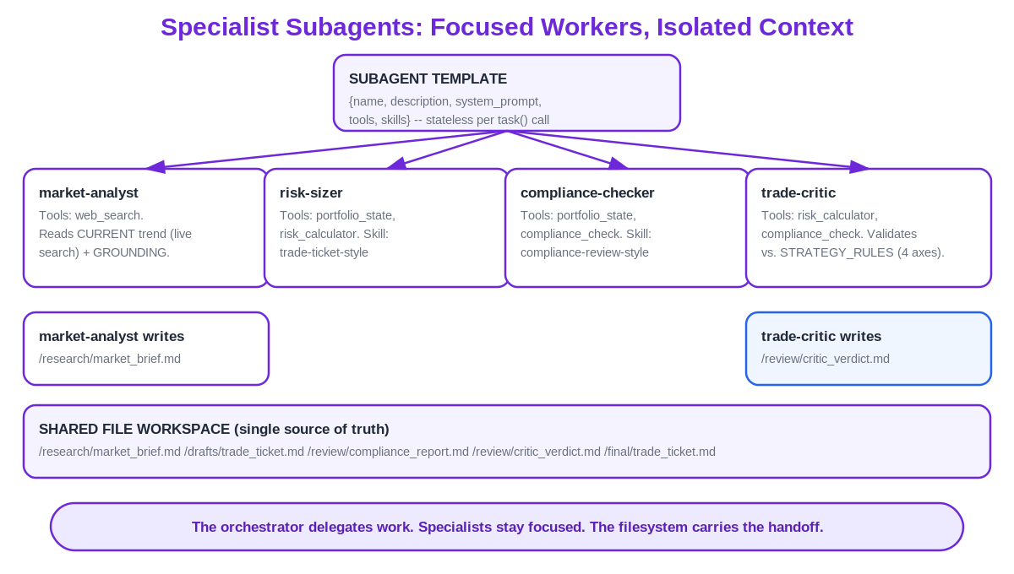
Specialist Subagents: Focused Workers, Isolated Context
Trade Deep Agent | Agentic AI Systems Project
12

Slide 13
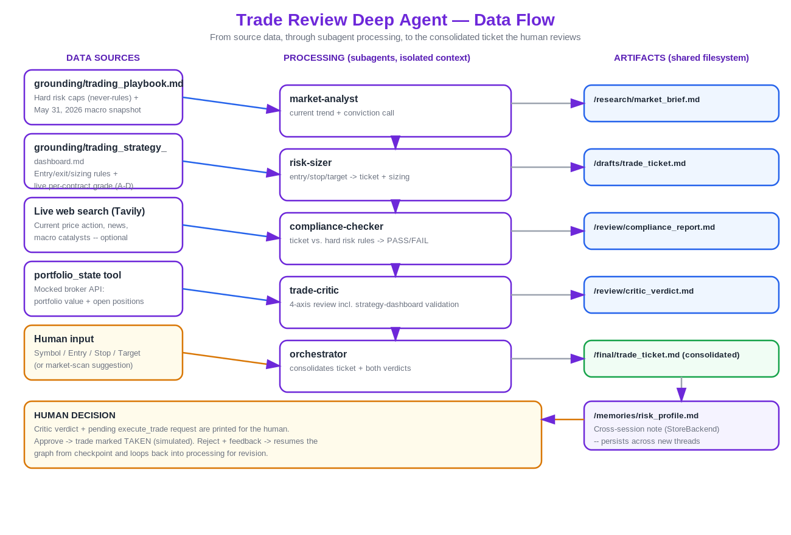
Data Flow
Trade Deep Agent | Agentic AI Systems Project
13

Slide 14
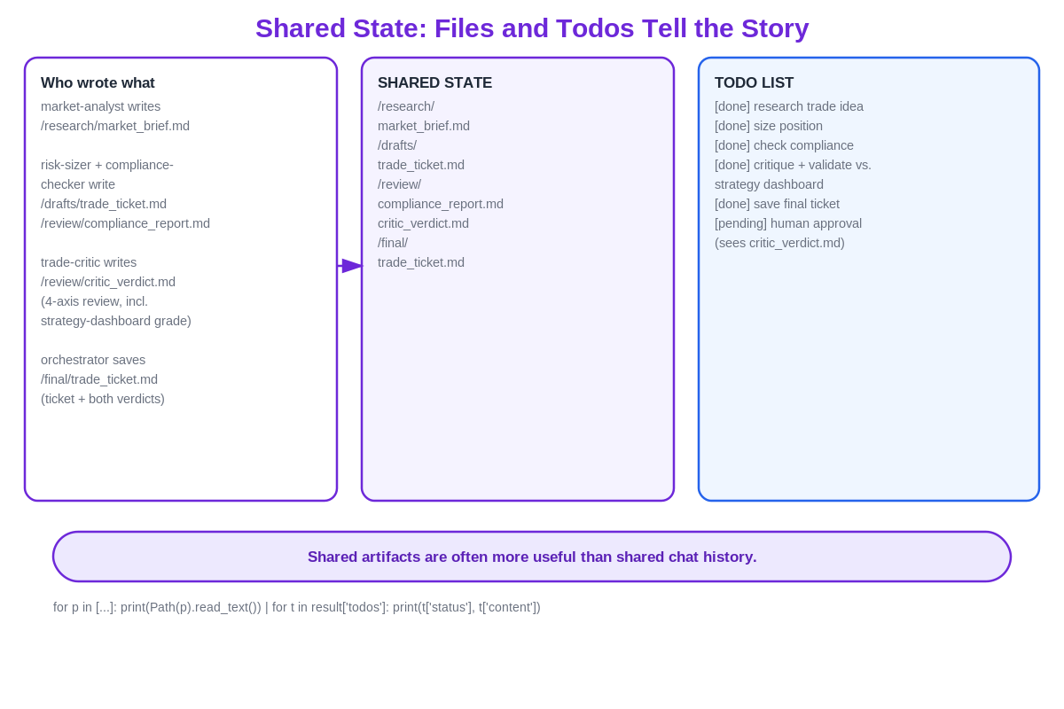
Shared State: Files and Todos Tell the Story
Trade Deep Agent | Agentic AI Systems Project
14

Slide 15
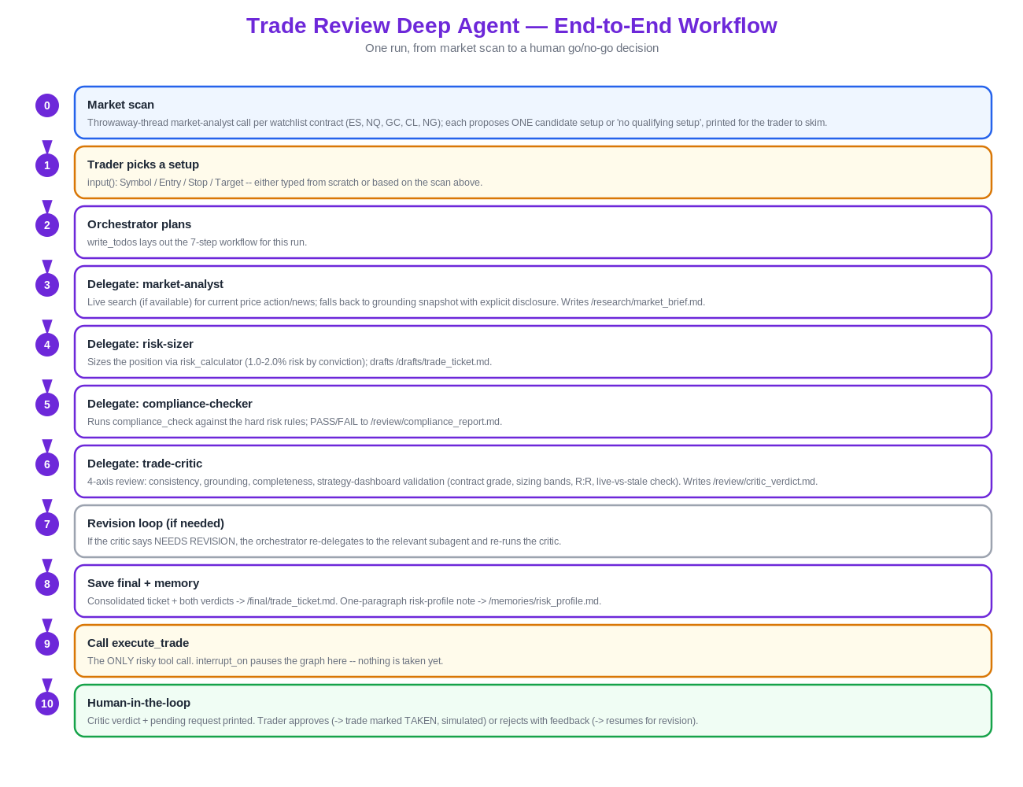
Run-Time Workflow
Trade Deep Agent | Agentic AI Systems Project
15

Slide 16
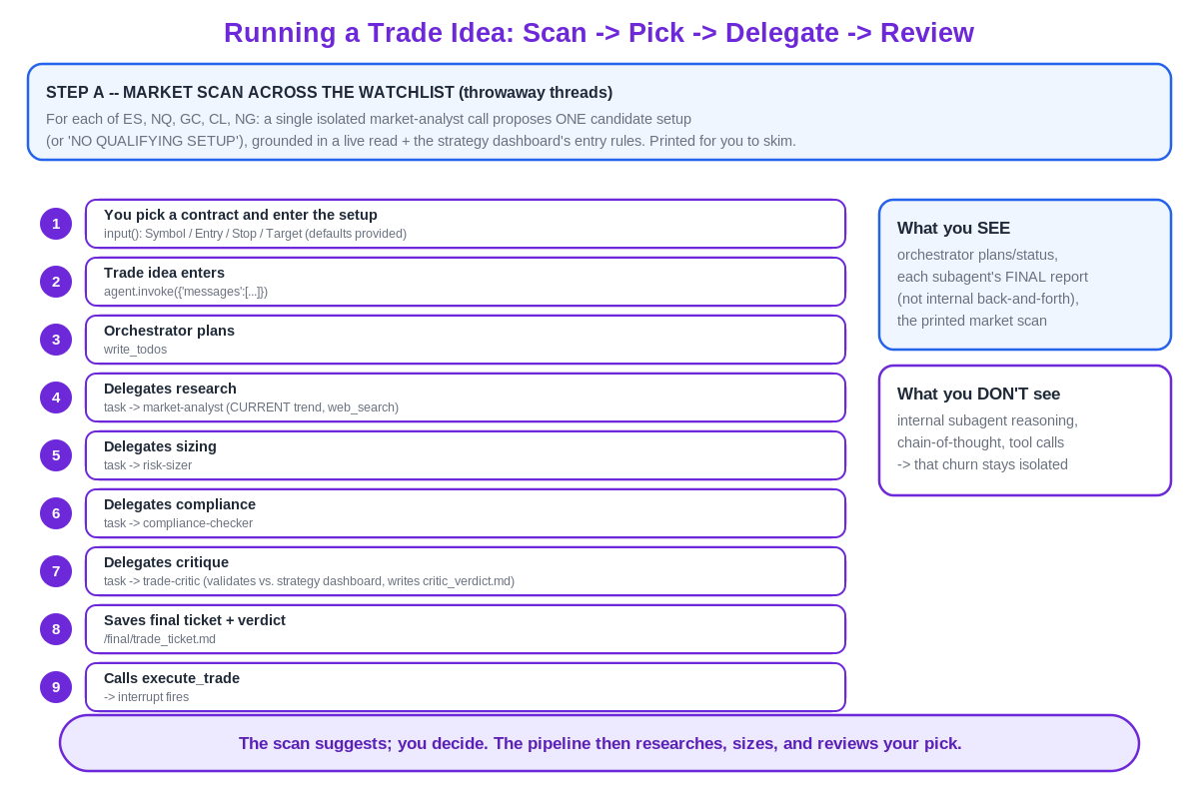
Running a Trade Idea: Scan, Pick, Delegate, Review
Trade Deep Agent | Agentic AI Systems Project
16

Slide 17
Human-in-the-Loop: People Stay in Control
Every trade idea is researched, sized, and reviewed by the agent — but no trade is ever recorded without an explicit human decision. interrupt_on pauses the graph at the approval step and surfaces the full agent reasoning, the critic's verdict, and the compliance result for the reviewer.
STEP 1
STEP 2
STEP 3
STEP 4
Agent prepares
Graph pauses
Human decides
Action recorded
Market read, risk sizing, compliance check, and critic verdict are assembled and presented together.
interrupt_on halts execution before execute_trade — the workflow cannot proceed unattended.
Reviewer approves, edits parameters, or rejects via Command(resume=...); the decision is explicit and logged.
execute_trade runs only after approval — and remains a SIMULATED tool, never a live order, in this project.
Trade Deep Agent | Agentic AI Systems Project
17

Slide 18
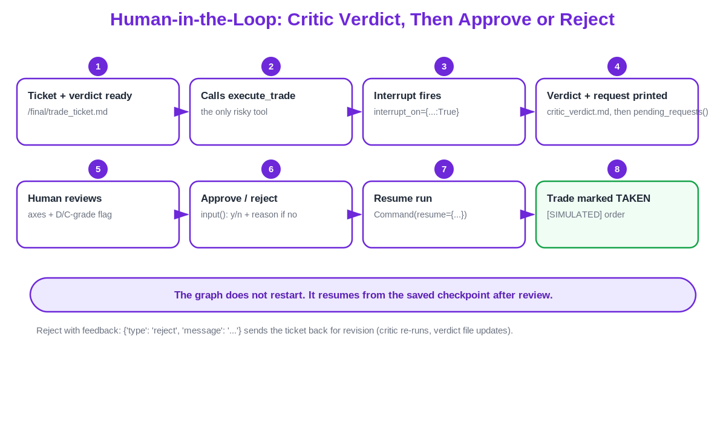
Human-in-the-Loop: Critic Verdict, Then Approve or Reject
Trade Deep Agent | Agentic AI Systems Project
18

Slide 19
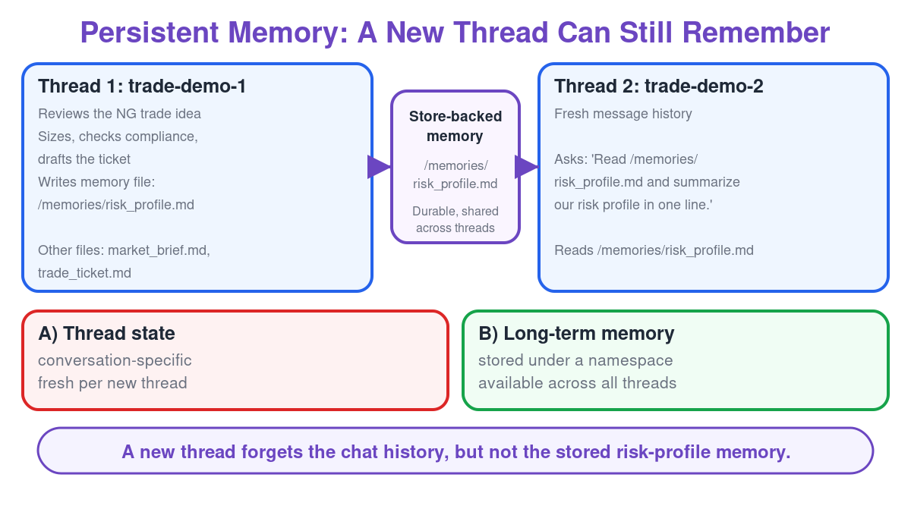
Persistent Memory: A New Thread Can Still Remember
Trade Deep Agent | Agentic AI Systems Project
19

Slide 20
MONITORING & OBSERVABILITY
Watching the Agent Work: LangSmith on trade-deep-agent
Live cost, latency, and error-rate telemetry captured from the project's own LangSmith traces.

Slide 21
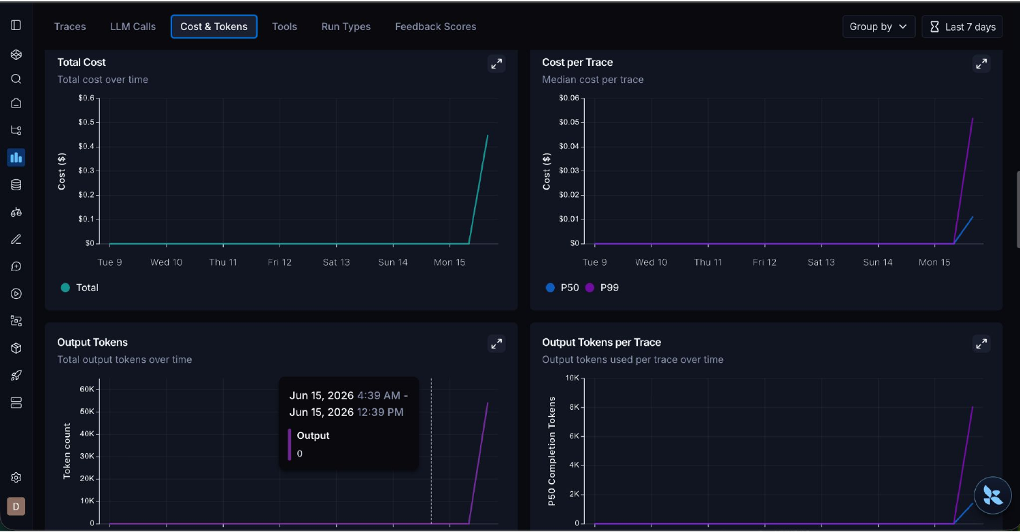
Monitoring: Cost & Token Usage
LangSmith — trade-deep-agent project, Cost & Tokens tab
Trade Deep Agent | Agentic AI Systems Project
20

Slide 22
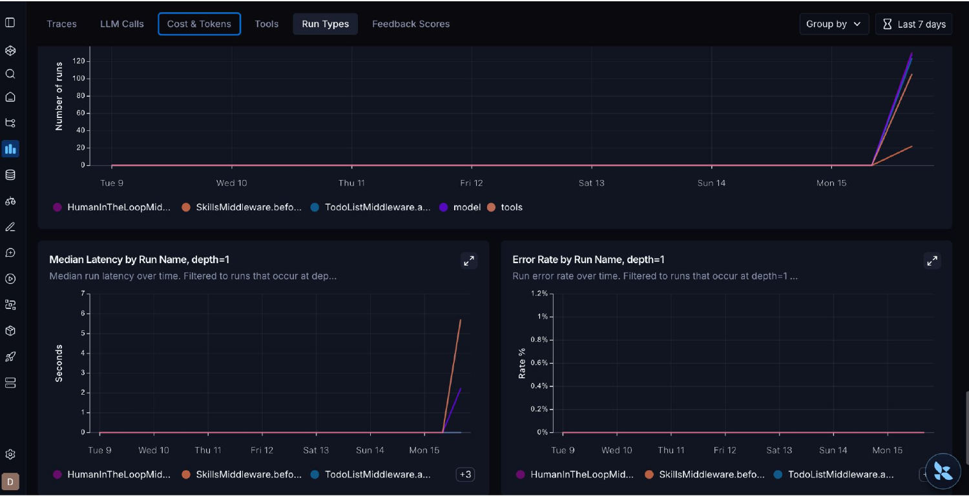
Monitoring: Run Types — Volume, Latency, Errors
Runs by middleware/component: HumanInTheLoopMiddleware, SkillsMiddleware, TodoListMiddleware, model, tools
Trade Deep Agent | Agentic AI Systems Project
21

Slide 23
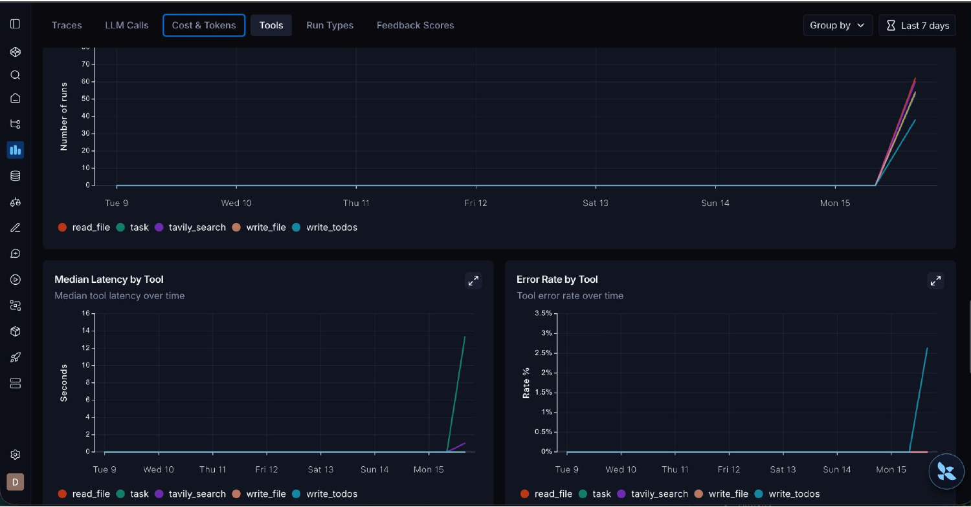
Monitoring: Tool-Level Performance
Per-tool runs, median latency, and error rate: read_file, task, tavily_search, write_file, write_todos
Trade Deep Agent | Agentic AI Systems Project
22

Slide 24
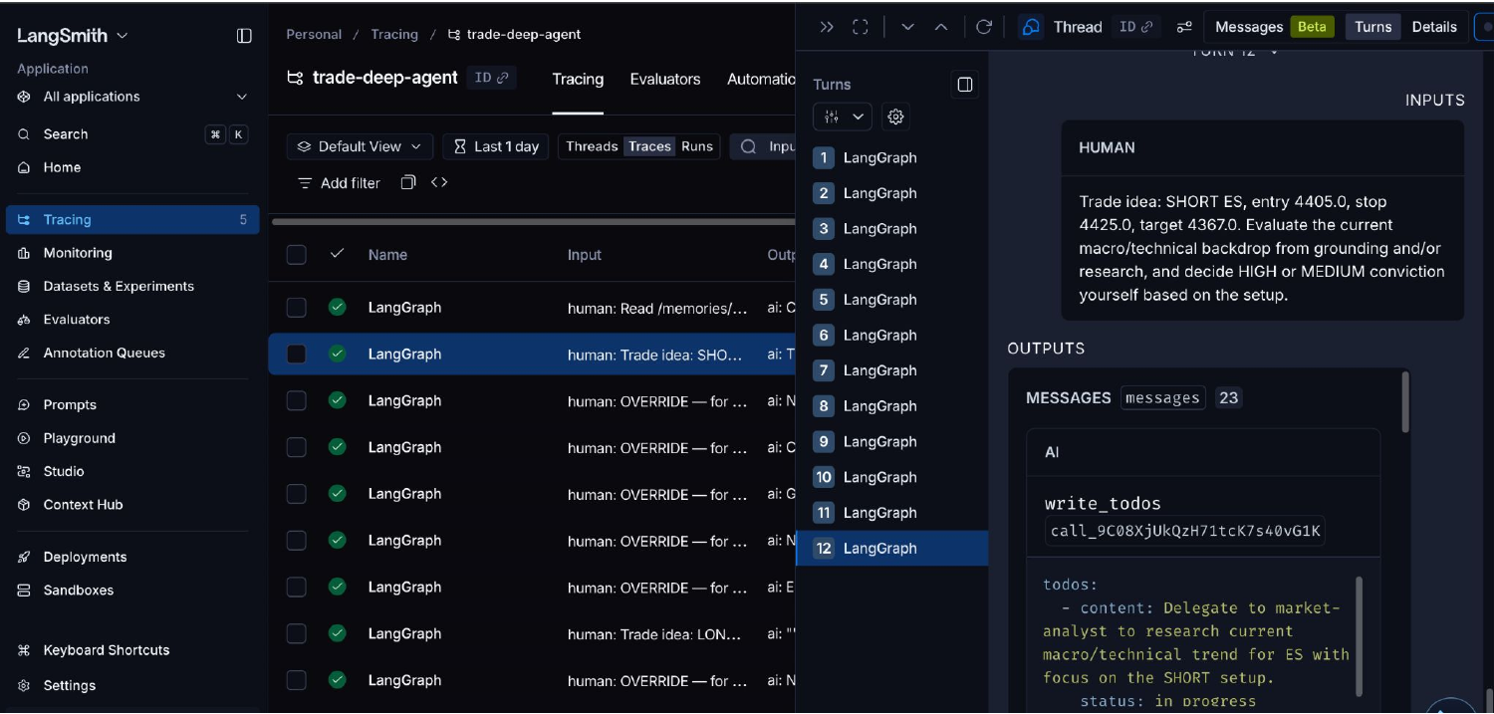
Monitoring: Full Trace Inspection
Every run — including each human override and trade-idea input — is traceable down to individual tool calls (e.g. write_todos) and their arguments.
Trade Deep Agent | Agentic AI Systems Project
23

Slide 25
Benefits & Value Add to Trade Review
1
2
3
Consistency
Speed
Auditability
Every trade idea runs through the same market read, sizing check, and compliance gate — no skipped steps.
Parallelizable subagent research and automatic todo tracking compress review time without compressing rigor.
Shared filesystem memory and LangSmith traces leave a durable, inspectable record of every decision.
4
5
6
Compliance-by-design
Safe automation
Continuous oversight
Risk and compliance checks run before the human ever sees the trade for approval, not after.
execute_trade is gated by mandatory human approval and remains simulated — automation augments judgment, it doesn't replace it.
Cost, latency, and error-rate monitoring via LangSmith make agent reliability measurable, not assumed.
Trade Deep Agent | Agentic AI Systems Project
24

Slide 26
Trade Deep Agent
A demonstration of agentic AI applied to trade idea review and compliance — with humans making every final decision.
DISCLAIMER
This project is an educational demonstration of agentic AI system design. execute_trade is a SIMULATED tool only — no real trades, transfers, or financial actions are executed. Nothing in this presentation constitutes investment, legal, or financial advice. All trade ideas require human review and approval, and any real-world use would require independent compliance, risk, and legal sign-off.
Questions & Discussion

